Slide 1

FINAL PROJECT REPORT
Module IRT
Information Retrieval
Techniques
Metadata-Driven Intelligent News Article Retrieval System
A standalone, offline-capable search engine combining Lexical and Semantic retrieval strategies to parse 120,000+ digital news articles efficiently
2026
120,000+ Articles
Hybrid AI Search

Slide 2
AGENDA
Table of Contents
01
Project Overview & Objectives
02
System Architecture
Core goal, 9-week development timeline, and key milestones from ingestion to evaluation
Data flow pipeline, hybrid search strategy, generative AI integration, and UI design
03
Challenges & Resolutions
04
Evaluation & Results
Three critical technical obstacles and engineering solutions implemented
Empirical metrics, synthetic ground truth validation, and performance findings
05
Conclusion & Future Scope
Summary of achievements and roadmap for real-time streaming index rebuilds

Slide 3

CHAPTER 01
Project Overview
& Objectives
Goal, timeline, and key objectives of the IRT module

Slide 4
PROJECT OVERVIEW
Objectives & Timeline
Core Objective
Engineer a standalone, offline-capable search engine combining Lexical and Semantic retrieval strategies to parse 120,000+ digital news articles efficiently. The system transitions beyond rudimentary keyword search, introducing dense semantic vectors, custom evaluation metrics, and Local LLM-augmented search explainability.
9-Week Development Timeline
1-2
Ingestion & Schema
3
Lexical Indexing
4
Semantic Vectors
Built news_fetcher.py, designed DuckDB schema, acquired ~120k articles
Implemented TF-IDF and BM25 indexing algorithms, tested lexical lookups
Implemented sentence-transformers (all-MiniLM-L6-v2) and FAISS indexing
5
Hybrid Fusion
6
Framework API
7
Frontend Architecture
Merged Lexical and Semantic results using RRF with temporal decay boosting
Wrapped retrieval logic in Flask REST APIs, built metrics capturing logic
Built IR mode UI using Vanilla JS with Tavily-inspired aesthetic
8
Generative AI
9
Evaluation & Tuning
System Complete
Implemented Local LLM bridge via LM Studio for contextual summarization
Generated synthetic ground-truths, plotted Precision-Recall curves, fine-tuned
Fully integrated hybrid search with AI explainability

Slide 5

CHAPTER 02
System
Architecture
Data flow pipeline, hybrid search, and UI design

Slide 6
SYSTEM ARCHITECTURE
Data Flow Pipeline & Storage
01
Raw Text Ingestion
02
Dual-Index Generation
03
Hybrid Search Retrieval
Input Sources
Sparse Index (BM25)
Dual Execution
Offline CSV files and live REST endpoints funnel into the pipeline
Pickled BM25 structural index maps term frequencies and exact phrase bounds
Both algorithms pull candidate lists simultaneously
Storage Engine
Dense Index (FAISS)
Normalization
DuckDB local serverless warehouse — eliminates need for complex cloud SQL instances
Pickled FAISS binary indices map vectors capturing conceptual tone and semantic meaning
Results normalized and ranked dynamically via formula fusion
Dynamic Ranking
Preprocessing
RRF with temporal decay — newer articles receive boosted weights
NLTK lowercasing, stopword dropping via preprocessor.py
120,000+ articles ingested
Two complementary indices
Unified results delivered
Key Innovation: The system seamlessly loads 120k+ articles into DuckDB and maintains two complementary indices — sparse for exact matching and dense for semantic understanding — enabling both precision and conceptual search capabilities.

Slide 7
SYSTEM ARCHITECTURE
The Hybrid Search Pipeline
Lexical Search (BM25)
Fusion Strategy: RRF
Searches bm25_index.pkl for exact keyword structural matches
Reciprocal Rank Fusion
Exceptional Recall — captures all documents containing query terms
Mathematically combines rankings from both indices using RRF formula with 50/50 blend weighting
Struggles mildly with semantic precision on nuanced queries
Semantic Search (FAISS)
Temporal Decay Boosting
Newer articles receive boosted weights, ensuring recency relevance in results
Passes queries through sentence-transformers (all-MiniLM-L6-v2)
Maps to conceptual dense space via faiss_index.faiss
0.80+ contextual Precision on nuanced concept queries
Dynamic Normalization
Candidate lists normalized and ranked dynamically for optimal result ordering
Query Processing Flow
User Query
NLTK Prep
Dual Search
RRF Fusion
Results

Slide 8
SYSTEM ARCHITECTURE
Generative AI Explainability Integration
The Problem
Technical Safeguards
Standard IR systems return a list of links — users still have to read through them. No contextual explanation of why results match the query, leading to cognitive overload and reduced search efficiency.
Context Truncation
Strictly limited to top 5 content_excerpt fragments maximum
Timeout Boundaries
Our Solution
Rigorous thread timeouts prevent AI failure from blocking UI
1
Intercept Top 5 Results
System captures the highest-ranked articles from hybrid search
Graceful Degradation
2
Local LLM Processing
Standard article population continues even if LLM fails
Passes through LM Studio (Mistral/Llama) for contextual analysis
3
AI-Generated Summary
Automatic summary placed at top explaining query-document matches
Local LLM Bridge
No cloud dependency — all processing happens on consumer hardware via LM Studio

Slide 9

CHAPTER 03
Challenges &
Resolutions
Key technical obstacles and engineering solutions

Slide 10
CHALLENGES & RESOLUTIONS
Three Critical Challenges
01
Severe RAM Saturation on FAISS Index Generation
The Problem
The Resolution
sentence-transformers embeddings over 120,000 articles instantly saturated System RAM, causing complete Flask server crashes during bulk ingestion
Decoupled index regeneration into offline background script (rebuild_index.py) that builds .faiss and .pkl binaries offline; main API loads into static read-only memory
02
Poor Ranking of Ambiguous Concepts
The Problem
The Resolution
Query "technology AI" returned articles mentioning "technology" 100 times before nuanced AI infrastructure discussions — pure lexical matching failed
Implemented true Hybrid Fusion — BM25 ensures target words exist, FAISS ensures context aligns. Mathematically forced 50/50 blend in standard model
03
Local LLM Timeout & Context Window Truncation
The Problem
The Resolution
Summarizing 10 retrieved articles via local Mistral/Llama broke context token limits, halting server execution completely
Truncated AI input to top 5 content_excerpt fragments maximum. Implemented rigorous thread timeout boundaries so LLM failure doesn't prevent standard article population

Slide 11
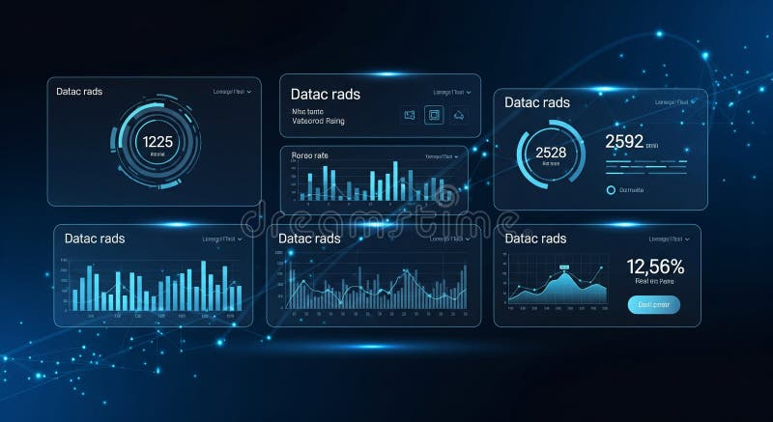
CHAPTER 04
Evaluation
& Results
Empirical metrics and performance validation

Slide 12
EVALUATION & RESULTS
Evaluation Metrics & Findings
Synthetic Ground Truth Methodology
Real-Time UI Metrics
Established mathematical ground truths by auto-generating targeted test files (generate_synthetic_data.py) to enable definitive mathematical validation of retrieval accuracy.
Precision@20
Real-Time
Recall Tracking
Key Performance Results
Embedded
BM25 Lexical
Exceptional Recall
Average Relevancy
Strong exact-match retrieval but mild semantic precision struggles on nuanced queries
Live Calc
Search Latency
FAISS Semantic
0.80+ Precision
< Milliseconds
Incredibly high contextual precision on nuanced concept queries
Hybrid Fusion
BEST MAP
Dramatically stronger MAP than out-of-the-box text searches across unstructured digital journalism datasets
Key Achievement
Unified hybrid approach outperforms standalone lexical or semantic methods

Slide 13
CONCLUSION & FUTURE SCOPE
Conclusion & Future Scope
Project Conclusion
Future Scope
Successfully bridged modern enterprise Information Retrieval concepts with localized, embedded, consumer hardware
Real-Time Streaming Index Rebuilds
Transition FAISS build generation to active background synchronization pool using Redis/Celery for cumulative on-the-fly index rebuilding
Moved beyond Google-style primitive scraping — system fully analyzes semantic density internally without cloud dependency
Proved that semantic hybrid searches yield better relevancy than strictly lexical queries across 120,000+ articles
Dynamic Warehouse Integration
Eliminate batched offline reconstruction — index rebuilds automatically as new news enters the database
Achieved real-time metrics tracking (Precision@20, Recall, Latency) with millisecond response times
Scalability Enhancements
Key Achievements
Support for larger corpora beyond 120k articles with distributed processing capabilities
Standalone
Hybrid Search
No cloud required
BM25 + FAISS
Vision: A fully autonomous, self-updating semantic search engine operating entirely on local infrastructure with zero cloud dependency.
AI Summary
Real-Time Metrics
Local LLM bridge
Live evaluation

Slide 14
Thank You
Information Retrieval Techniques
Final Project Presentation
Hybrid Search
AI-Powered
Real-Time Metrics
BM25 + FAISS
Local LLM Integration
Live Evaluation

